Slide 1

HACKATHON PROJECT
TOPIC - Calculate Trip Cost
Website –www.tripadvisor.in

Slide 2
PROJECT
DESCRIPTION
Display Hotel name, total amount and charges per night for 3 holiday homes for 4 people in Nairobi for 5 days of stay from tomorrow's date.
Sort the list with highest traveler rating on top & should have elevator/ List access
Pick one cruise line & pick a respective cruise ship under Cruises: a. Retrieve all the languages offered and store in a List; Display the same b. Display passengers, crew & launched year

Slide 3




TOOLS,LANGUAGES AND LIBRARIES USED
Java
Eclipse IDE
Selenium Framework
TestNG Framework
Maven Tool
Apache POI
POM
Extent HTML Report

Slide 4
Project
Architecture
Launch the browser
Open Trip Advisor site (https://www.tripadvisor.in)
Click on holiday homes
Enter "Nairobi" in "Where to" textbox field
Choose "Traveller Rating" in Sort by dropdown
Select "Show more" under "Amenities" and choose Elevator/Lift access
Select Check-in and Check-out dates
Select No. of Guests
Close and Launch the URL again
Select “Traveller’s Choice” under “more “ option
Select "Cruises“
Choose Cruise Line and Cruise Ship and select "Search"

Slide 5
The main Two scenarios were separated into two classes under one package “pages”.
Total of 20 test cases were implemented in TestCases classes under “TestScenarios” package.
Input is taken from “config.properties” and “input.xlsx” file.
For HolidayHomes scenario the Output is printed in “Output.xlsx” .
For Cruise Scenario the output is printed in “output01.xlsx”.
testng.xml file is called from CalculateTripCost suite which consists of both smoke and regression test.
Code flexibility is kept so that changes can be made and test cases can be changed easily.
CODE FRAMEWORK

Slide 6
The hackathon project idea is tested manually at first.
The code is written in JAVA language and automated using Selenium.
Page Object Model (POM) is used to reduce code duplication.
TestNG is used to Segregate Smoke and Regression tests.
Data obtained is stored in Excel sheet using Apache POI.
Prepared reports like requirement document, test plan, test cases , test summary and Automation feasibility report.
Html report is generated using Extent report.
Automation testing of the website is done and verified.
WORK DONE

Slide 7
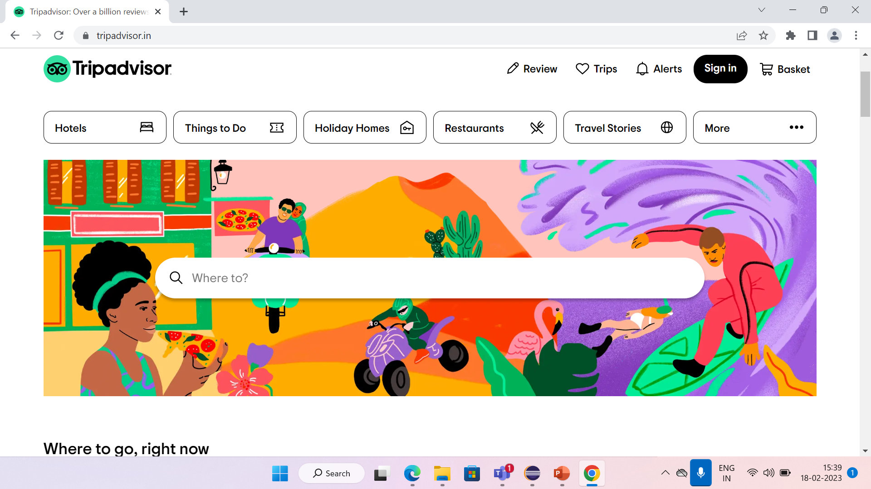
REAL TIME SCREENSHOT

Slide 8
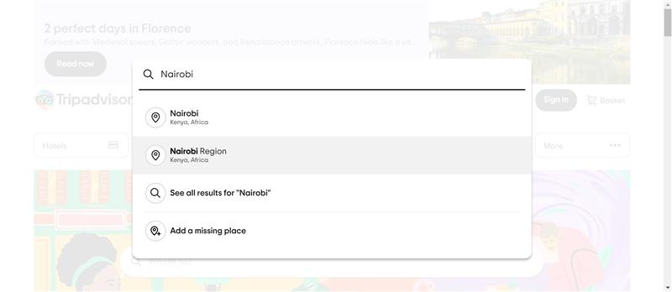
REAL TIME SCREENSHOT

Slide 9
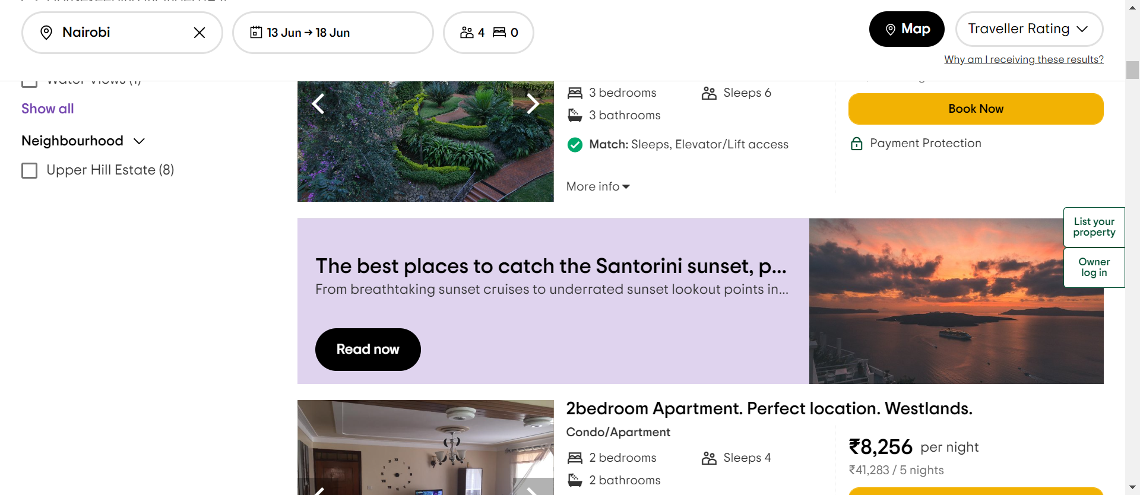
REAL TIME SCREENSHOT

Slide 10
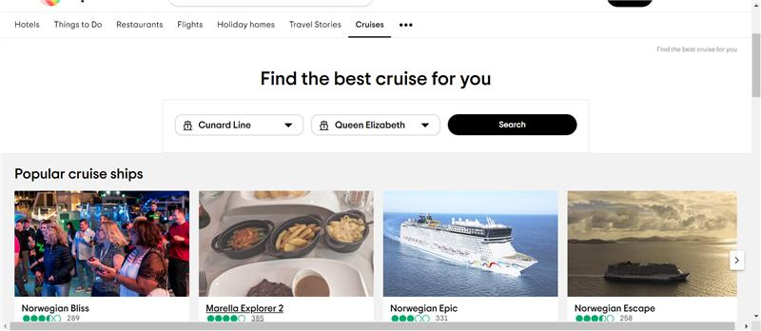
REAL TIME SCREENSHOT

Slide 11
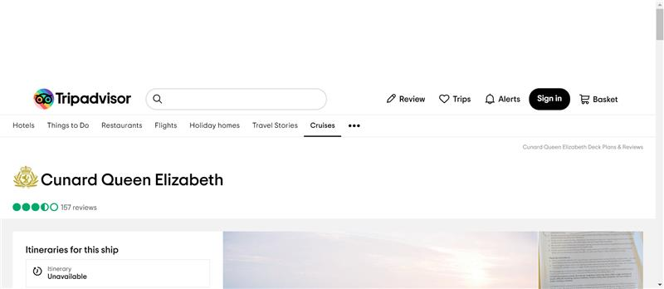
REAL TIME SCREENSHOT

Slide 12
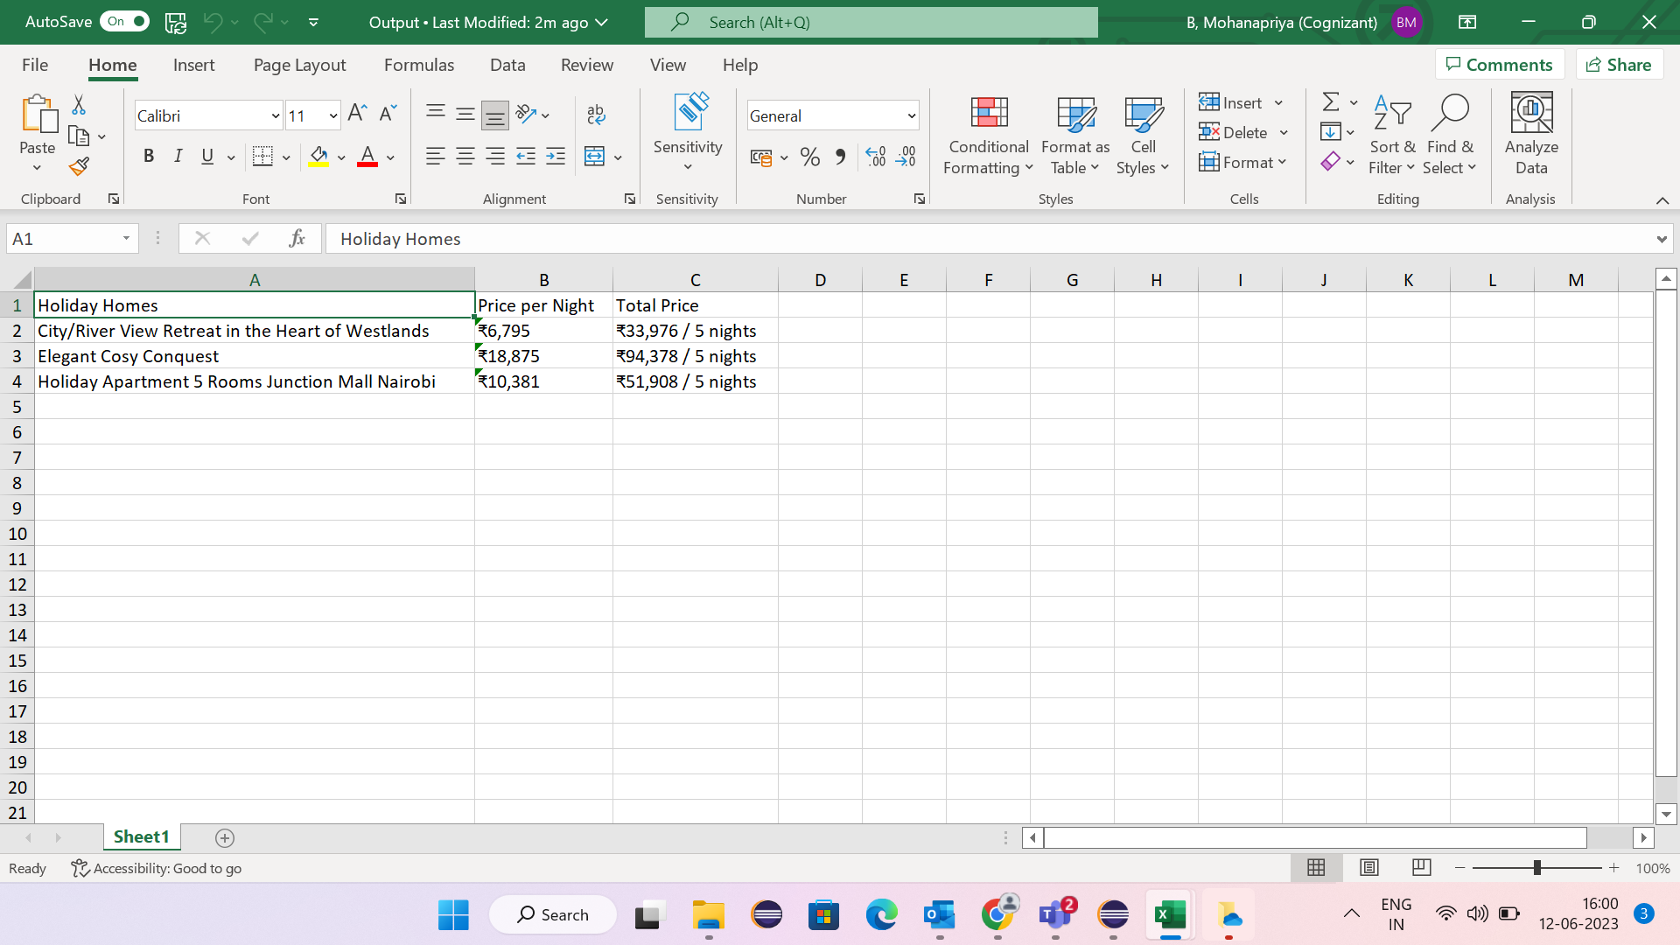
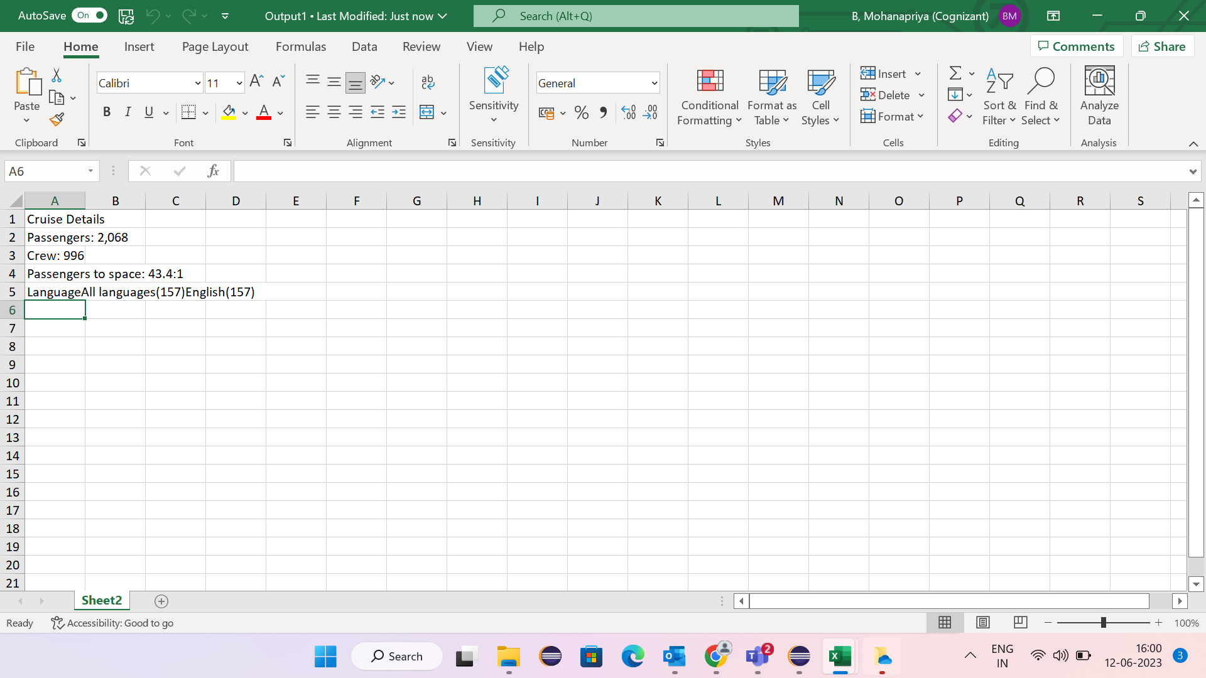
Excel outpuT

Slide 13
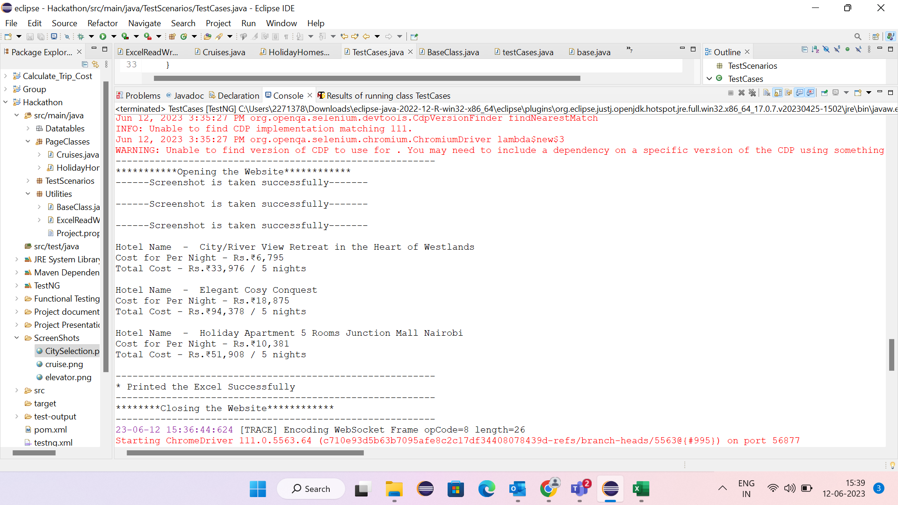
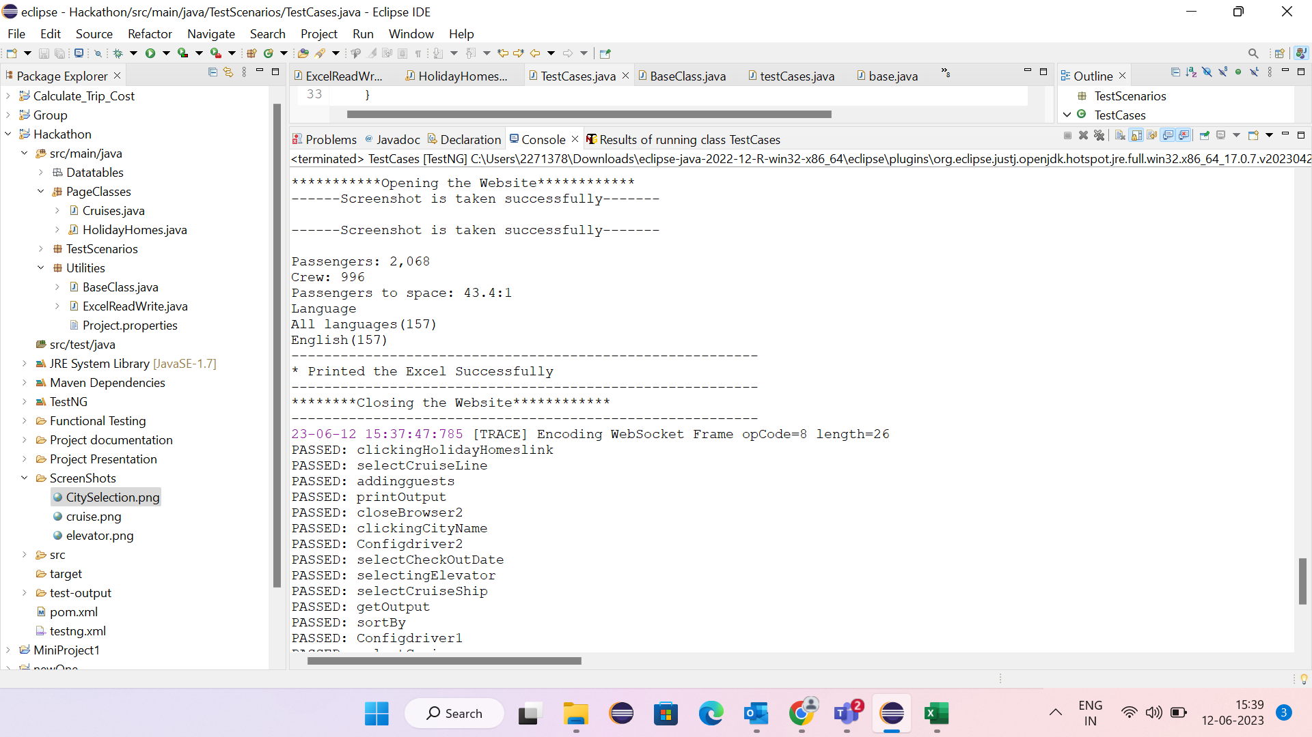
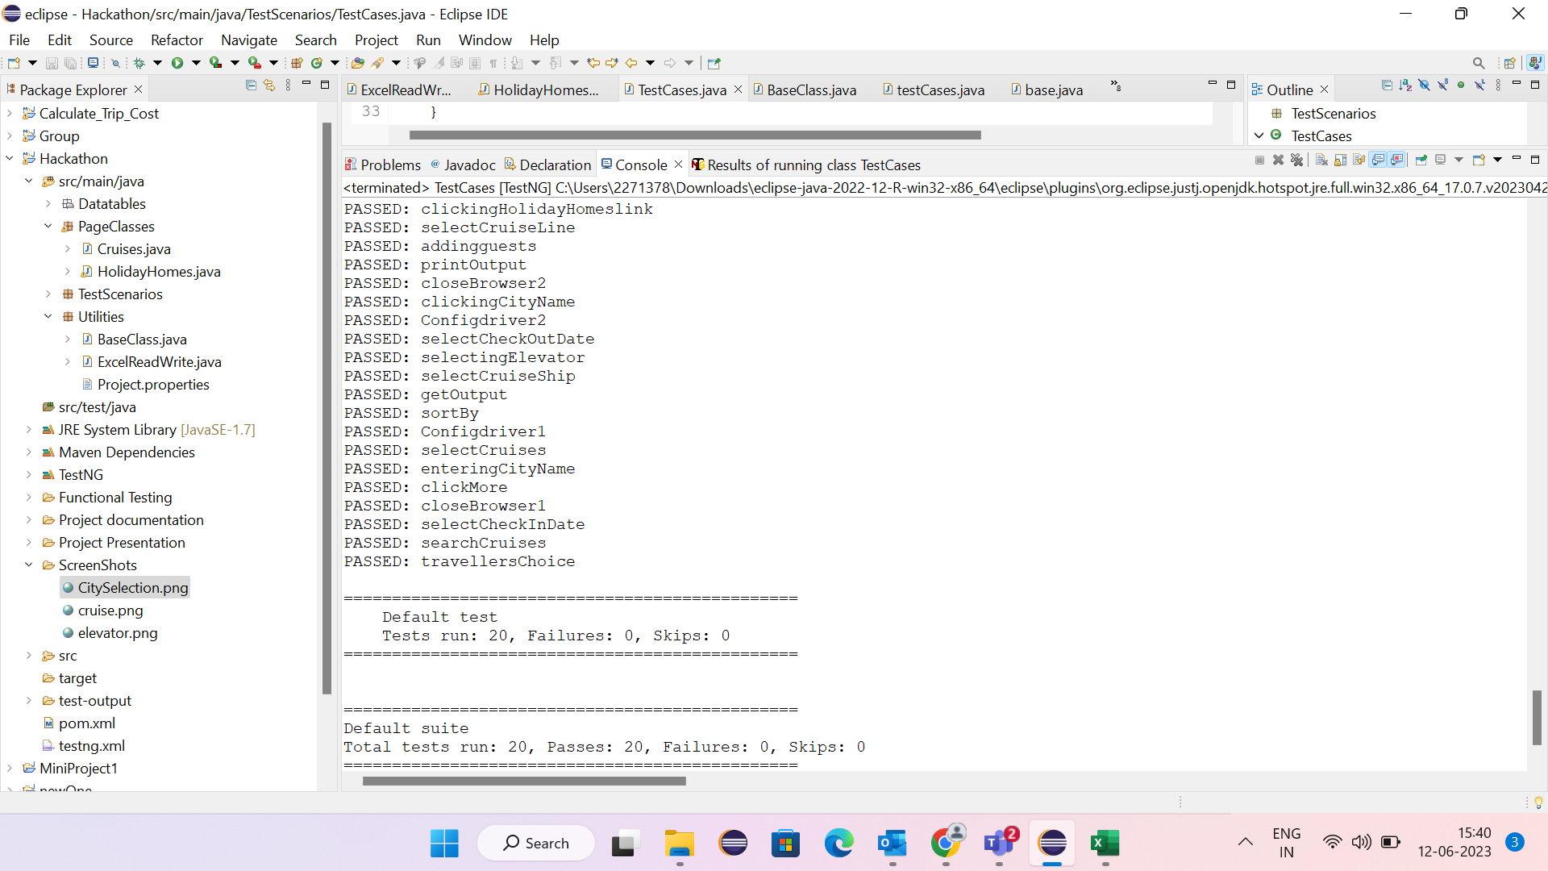
CONSOLE outpuT

Slide 14
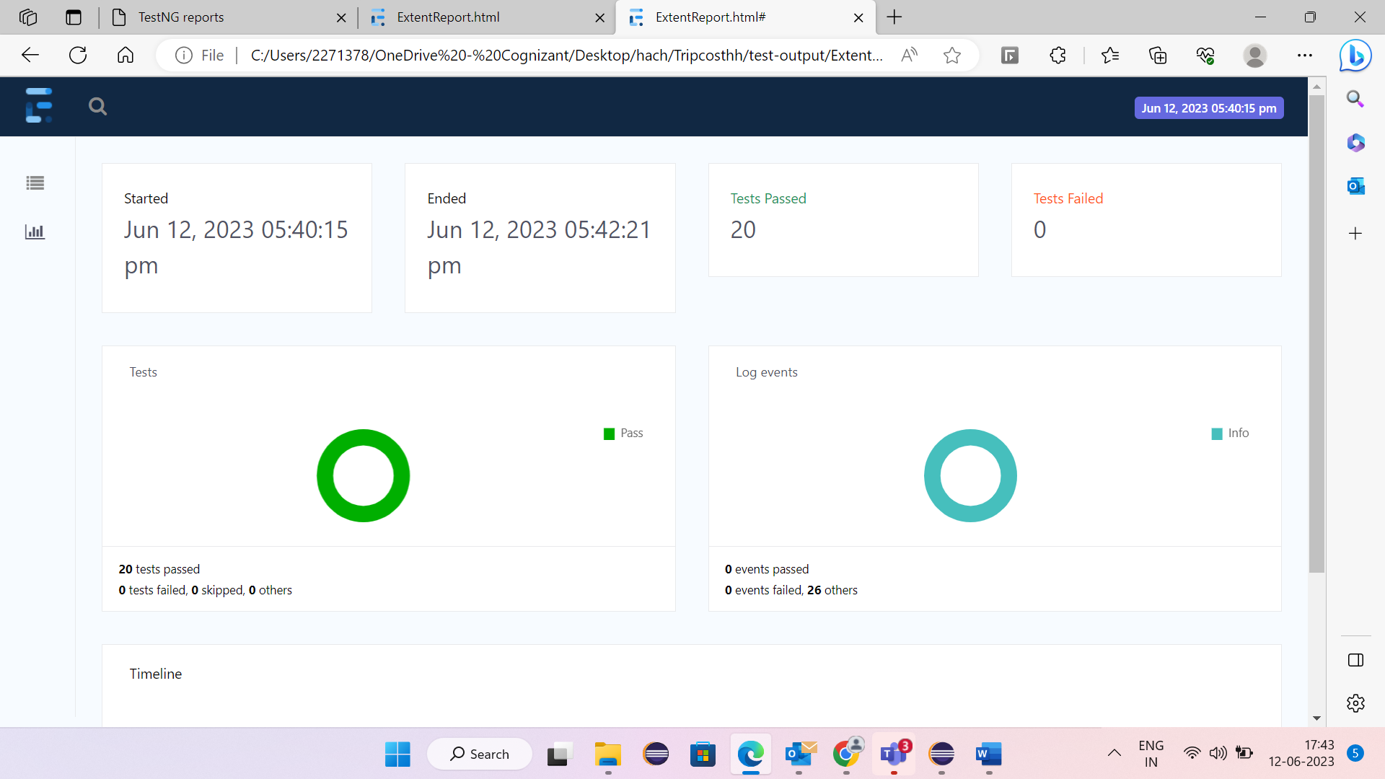
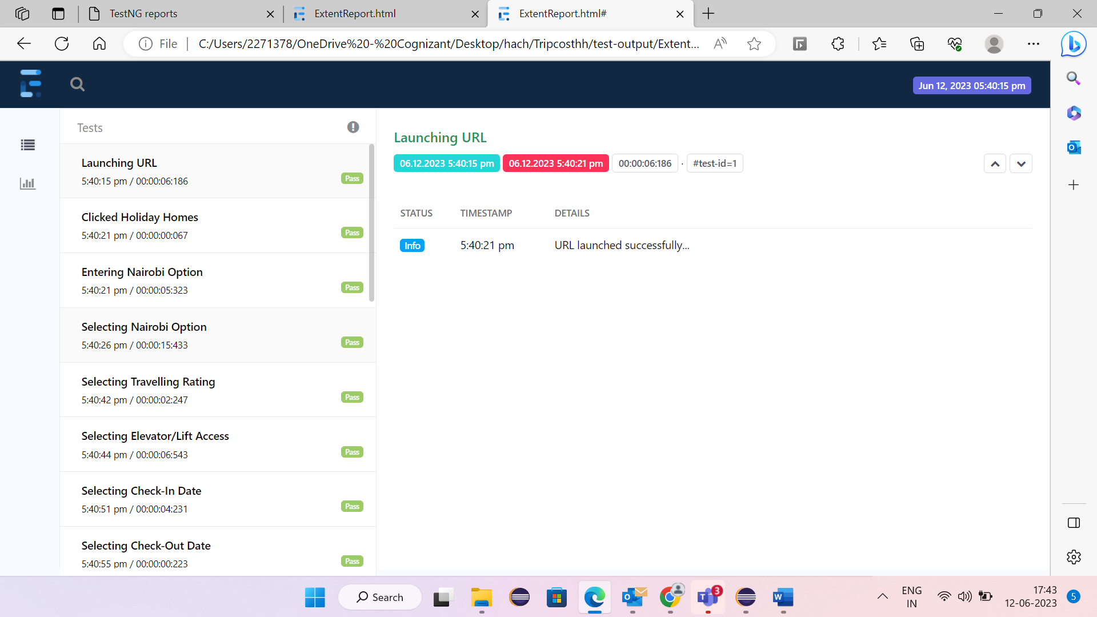
ExTENT REPORT

Slide 15

LEARNINGS
Handling different browser windows
Error handling
Date Controls
Time Management
Importance of Maven
Importance of TestNg

Slide 16
CONCLUSION
In this project we used different tools like Maven, TestNG, Selenium to automate tripadvisor.in in various browsers like Chrome, Edge.
This project has separate classes : for the methods , for basic setup ,to get the data from Excel and Testcase to execute the code.
Time can be saved by using automation.
Can easily find errors , if there are any!

Slide 17

Thank You

